Slide 1
Real-Time E-Commerce User Analytics and Recommendation System
MENTOR: V.Vinisha, Assoc.Prof.
BATCH NO: 13
TEAM MEMBERS:
Krithik Reddy – 2320030234 Karthikeya - 2320030501 Sai Bharadwaj – 2320030482

Slide 2
Table of contents
ABSTRACT
INTRODUCTION
EXISTING SYSTEM
PROPOSED SYSTEM
OBJECTIVES
LITERATURE SURVEY
SOFTWARE REQUIREMENTS
HARDWARE REQUIREMENTS
FUNCTIONAL REQUIREMENTS
NON – FUNCTIONAL REQUIREMENTS
SYSTEM ARCHITECTURE
UML DIAGRAM
ACTIVITY DIAGRAM
MODULE DESIGN

Slide 3
Review – 2 comments addressed
1. Clarify System Architecture
2. Add Machine Learning Component Clearly

Slide 4
ABSTRACT
Modern e-commerce platforms generate massive volumes of user activity data such as clicks, searches, cart additions, and purchases.
Traditional systems fail to process high-volume and high-velocity data in real time.
This project proposes a Real-Time E-Commerce User Analytics Dashboard using:
Apache Kafka (Data Streaming)
Apache Spark (Distributed Processing)
InfluxDB (Time-Series Storage)
Grafana (Visualization)
The system processes streaming data, integrates demographic information, and provides live analytics and recommendations.

Slide 5
Introduction
E-commerce platforms like Amazon and Flipkart generate millions of events every second.
Businesses need:
> Real-time insights
> Customer behavior analysis
> Sales performance tracking
> Personalized recommendations
Big Data technologies enable scalable and fault-tolerant real-time analytics.

Slide 6
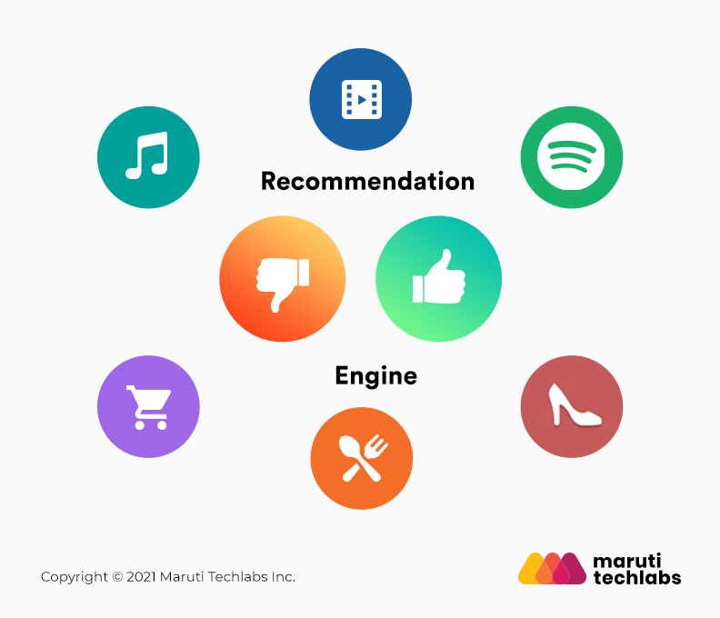
Existing system
In traditional e-commerce systems:
Data is stored in relational databases.
Analytics is performed using batch processing.
Reports are generated daily or weekly.
No real-time monitoring of user behavior.
Recommendations are not updated instantly.
Difficult to handle high-volume streaming data.
Limitations of Existing System:
High latency in insights
No real-time decision making
Limited scalability
Poor handling of streaming data
Manual analysis required
Delayed campaign performance tracking

Slide 7
Proposed system
We propose a Real-Time E-Commerce User Analytics System using Big Data technologies.
Stream user events using Apache Kafka
Process data in real time using Apache Spark
Integrate demographic data from MySQL
Apply ML models for prediction & segmentation
Store metrics in InfluxDB
Visualize insights using Grafana
Benefits
Real-time analytics
Scalable & fault-tolerant
Faster business decisions

Slide 8
Objectives
Design a real-time data pipeline for e-commerce events
Process streaming data using Apache Kafka & Spark
Integrate structured demographic data
Apply ML models for prediction & segmentation
Build interactive real-time dashboards
Enable data-driven business decisions

Slide 9
Software requirements
Apache Kafka – Data Streaming
Apache Spark (Structured Streaming) – Real-time Processing
Spark MLlib – Machine Learning
MySQL – Structured Data Storage
InfluxDB – Time-Series Database
Grafana – Dashboard Visualization
Docker Compose – Container Management

Slide 10
Hardware requirements
CPU: Intel i5 or higher
RAM: 8 GB or higher
Storage: 20 GB free space
OS: Windows / Linux / macOS
Internet: Stable connection for cloud & streaming setup

Slide 11
FUNCTIONAL requirements
System Should capture real time user events (clicks, cart, purchases)
Process streaming data using kafka and spark
Integerate demographic data from MySQL
Apply ML models for prediction and segmentation
Store processed metrics in InfluxDB
Display live insights through Grafana dashboard

Slide 12
Non - functional requirements
Scalability: Handle high-volume streaming data
Reliability: Ensure fault-tolerant data processing
Performance: Provide low-latency real-time analytics
Security: Secure data transmission and access control
Availability: System should run continuously with minimal downtime

Slide 13
Literature survey
S. No | Name of the research paper | Author name | Technologies used | Advantages/ Disadvantages
1 | AI-Driven Recommendations | Sabina-Cristiana Necula | AI-based recommendation systems | Advantage: Improves personalization and customer experience. Disadvantage: Requires high memory and processing power.
2 | The Application of Artificial Intelligence in Electronic Commerce | Xia Song, Shiqi Yang, Ziqing Huang, Tao Huang | Artificial Intelligence techniques in E-commerce | Advantage: Enhances automation and decision-making. Disadvantage: Needs updates with deep learning and big data frameworks.
3 | Big Data Analytics in E-commerce | Samuel Fosso Wamba | Big Data Analytics | Advantage: Enables large-scale data analysis. Disadvantage: Assumes clean data; struggles with noisy real-world data.

Slide 14
Thank you
S. No | Name of the research paper | Author name | Technologies used | Advantages/ Disadvantages
4 | The Increasing Importance of AI Applications in E-commerce | A.A. Nimbalkar, A.T. Berad | AI Applications | Advantage: Shows impact of AI in business growth. Disadvantage: Tested on limited datasets; lacks real-world diversity.
5 | User-Centric Internal Tools in E-commerce | Xue Song | Sentiment Analysis (R-based tools) | Advantage: Focuses on customer feedback analysis. Disadvantage: Does not use big data frameworks like Spark/Hadoop.
6 | Real-Time Stream Processing with Apache Kafka and Spark | Jay Kreps, Neha Narkhede, Matei Zaharia | Apache Kafka, Apache Spark | Advantage: Supports scalable real-time data processing. Disadvantage: Requires complex setup and cluster management.

Slide 15
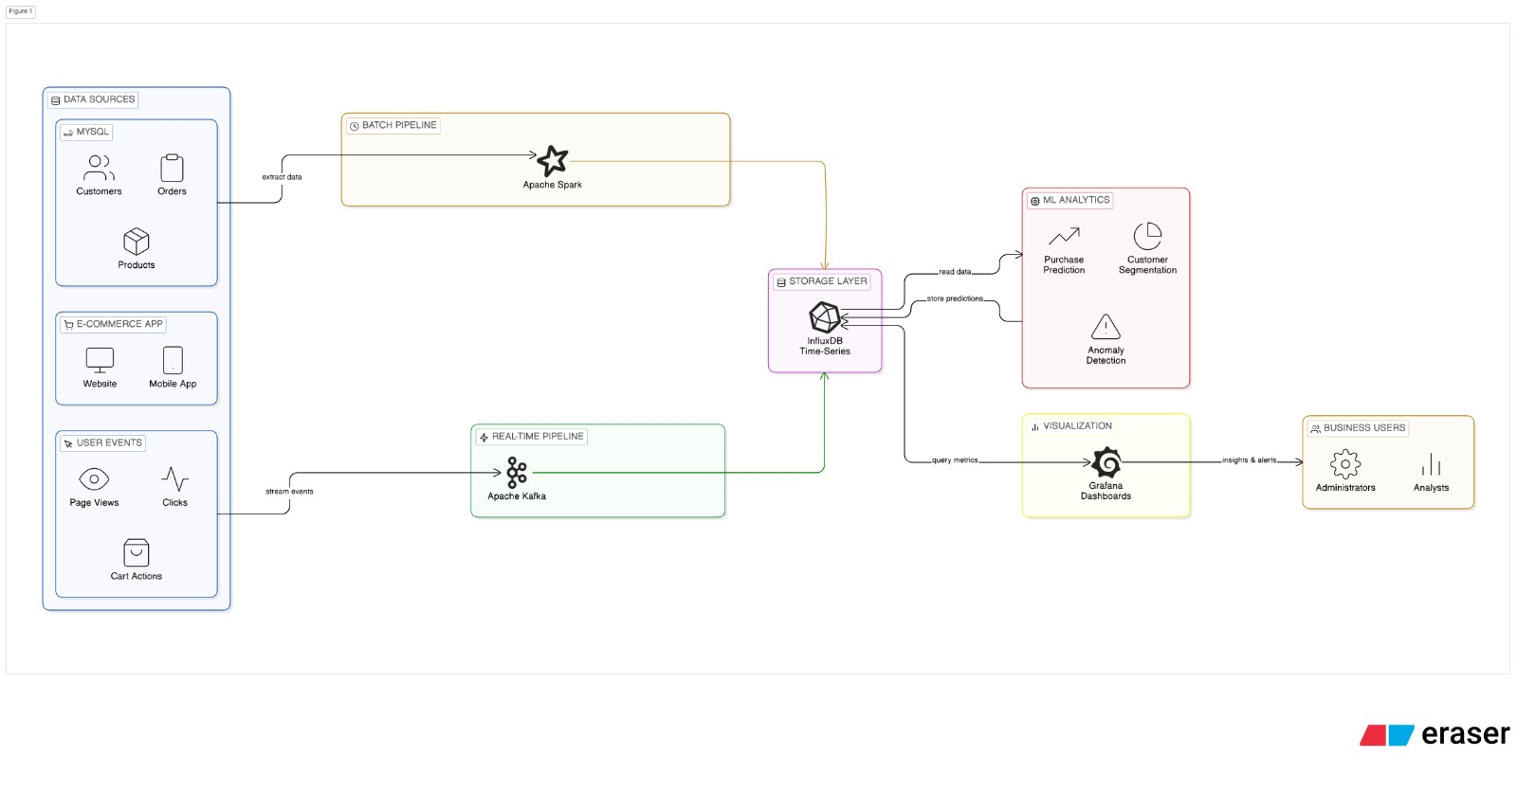
System Architecture
The system collects data from MySQL databases and real-time user events from the e-commerce application. Historical data is processed using Apache Spark, while live events are streamed through Apache Kafka. Processed metrics are stored in InfluxDB, where machine learning models perform prediction and segmentation. Grafana dashboards visualize real-time insights for business users.

Slide 16
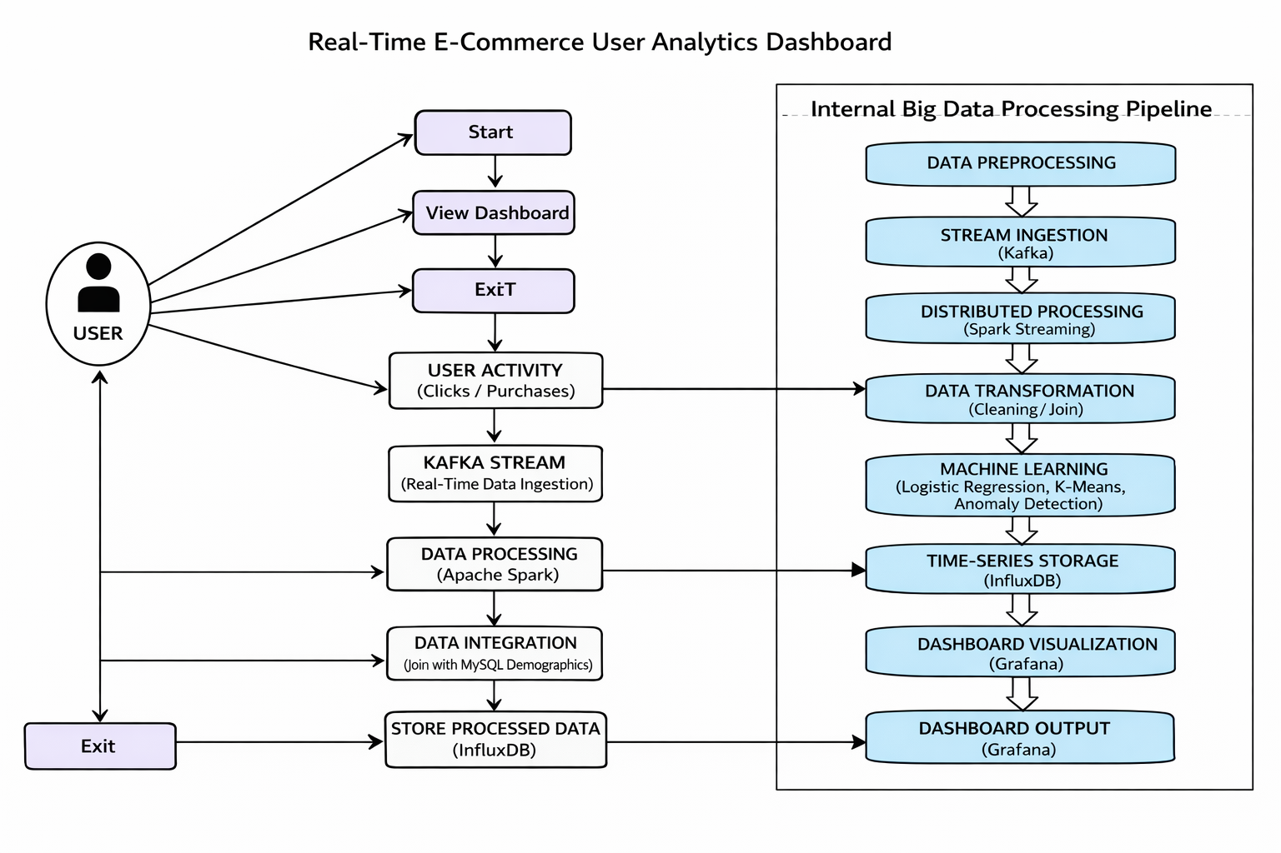
Uml diagram

Slide 17
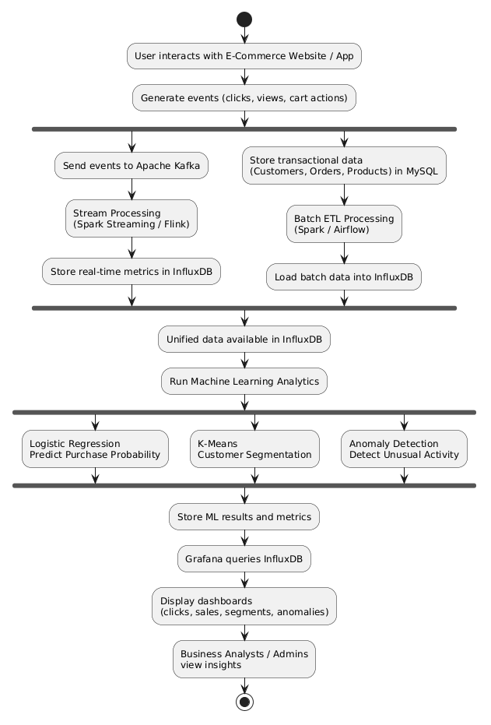
Activity diagram

Slide 18
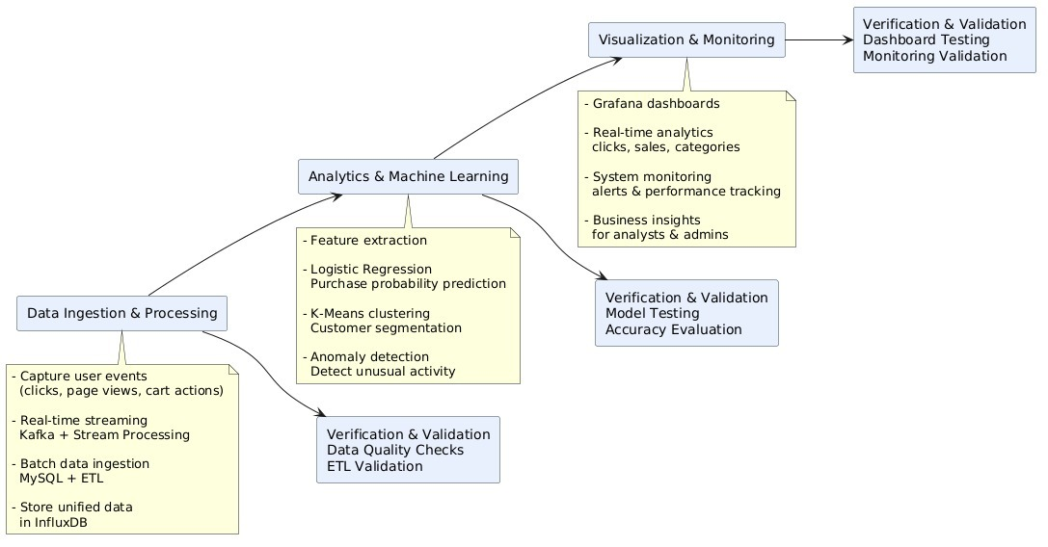
Module design

Slide 19


